Slide 1

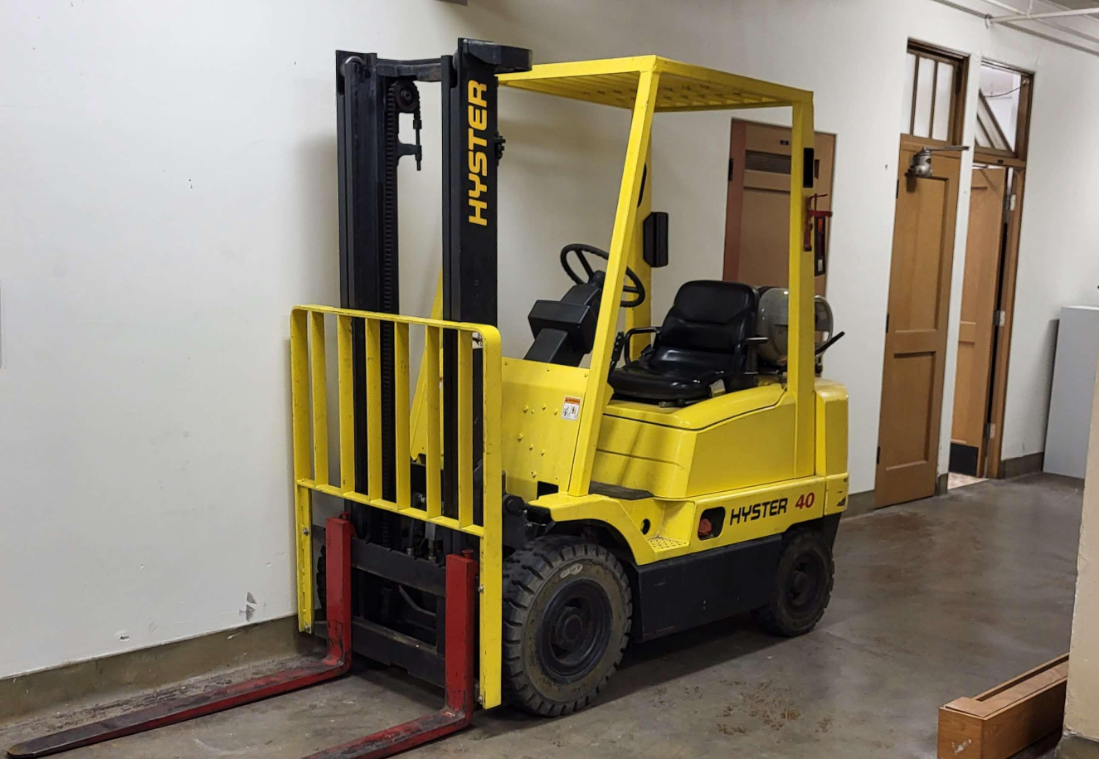
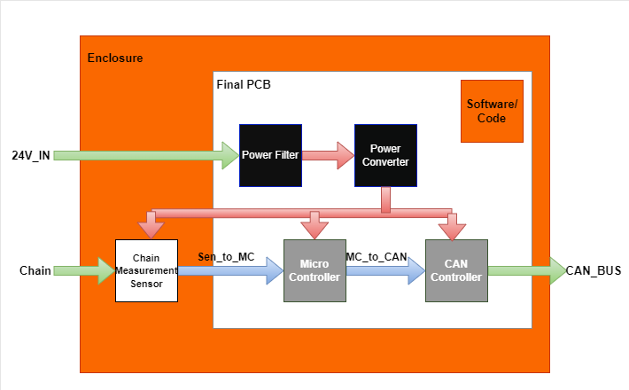
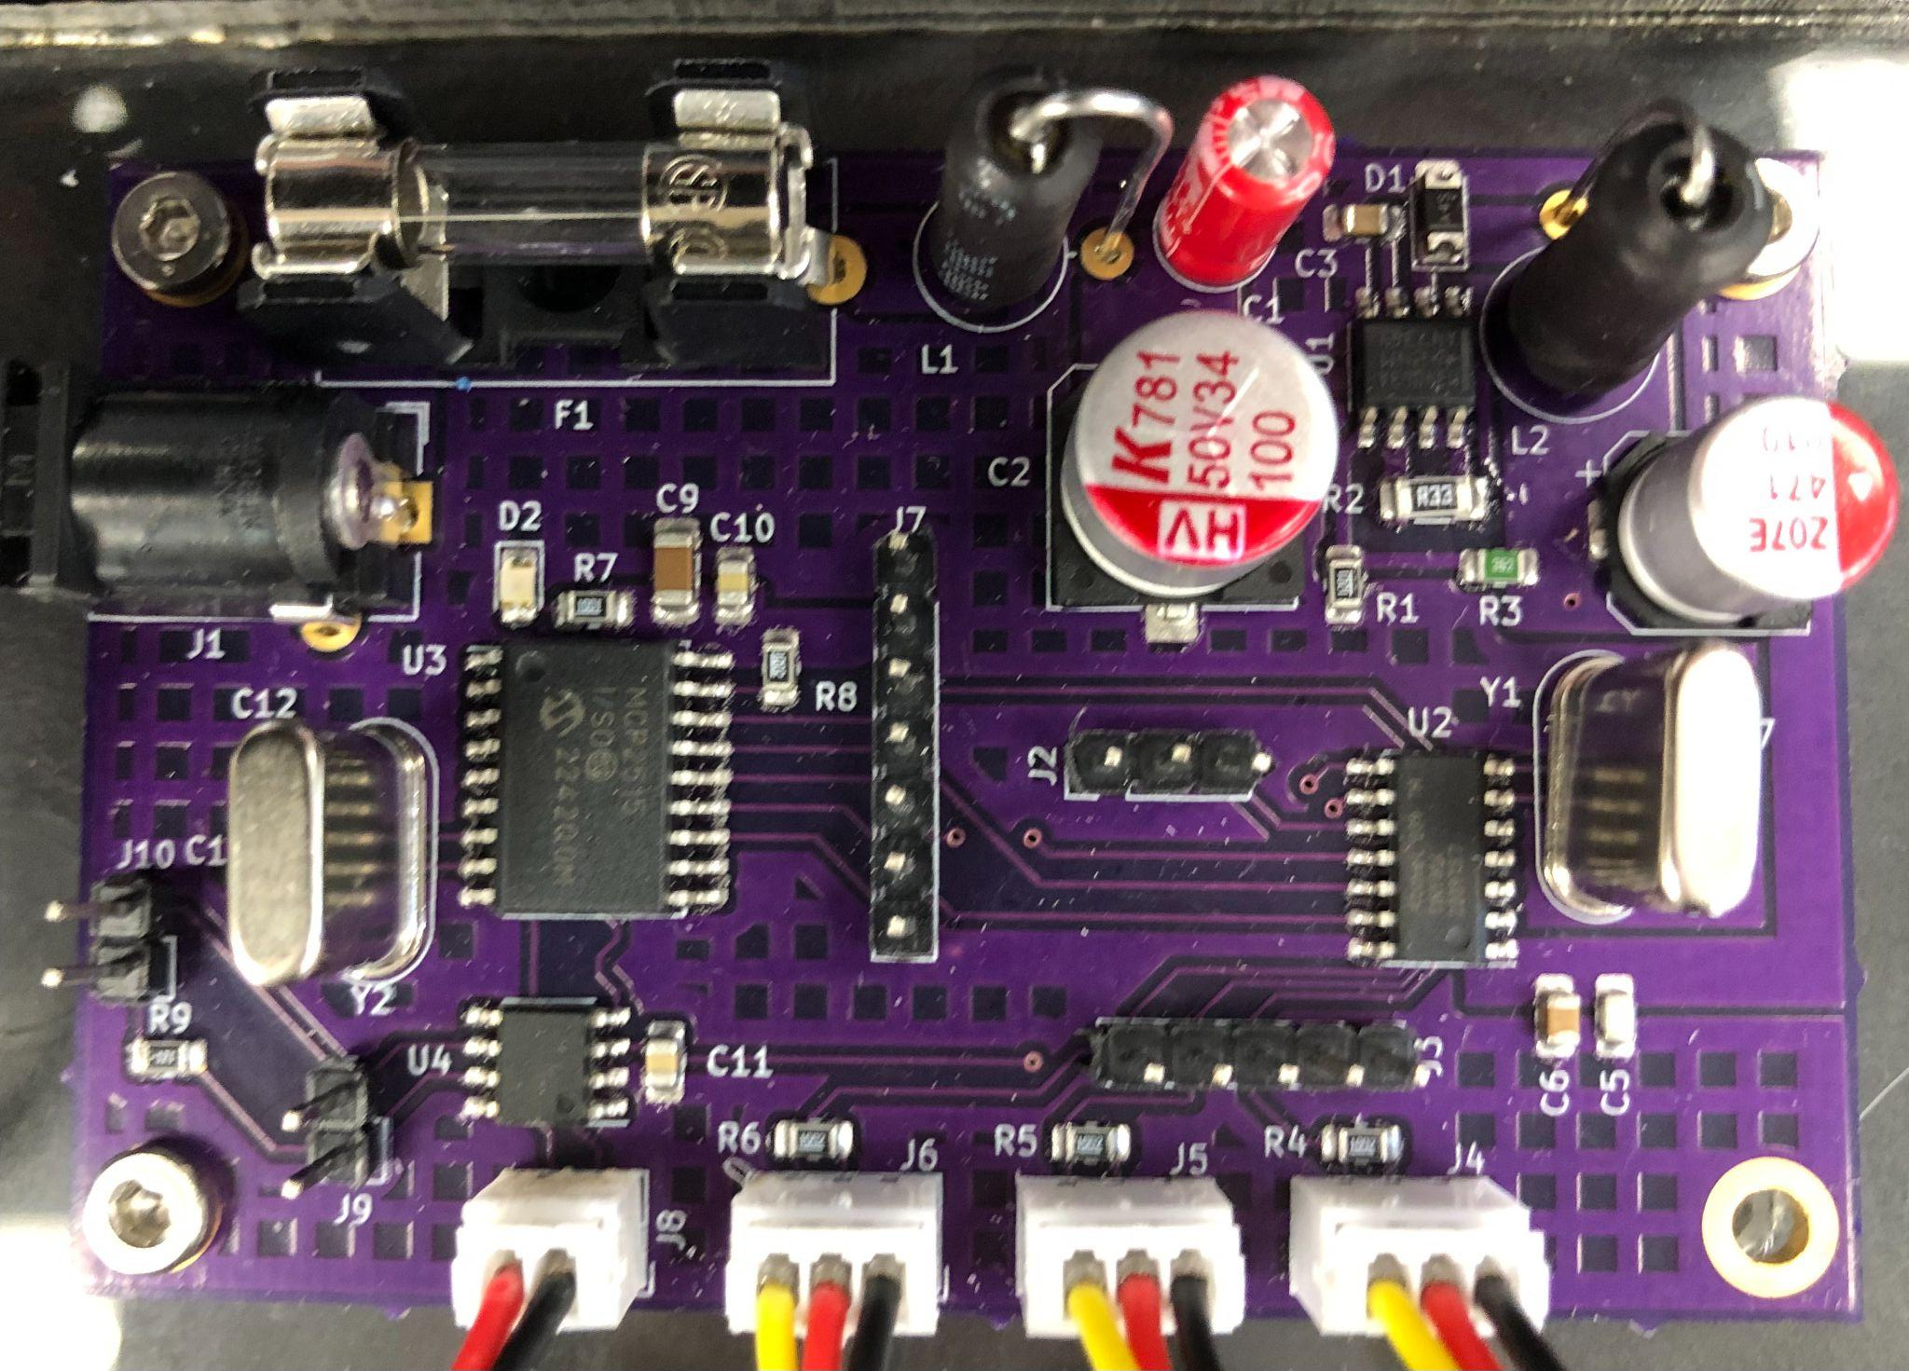
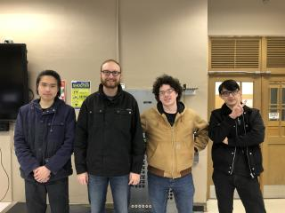
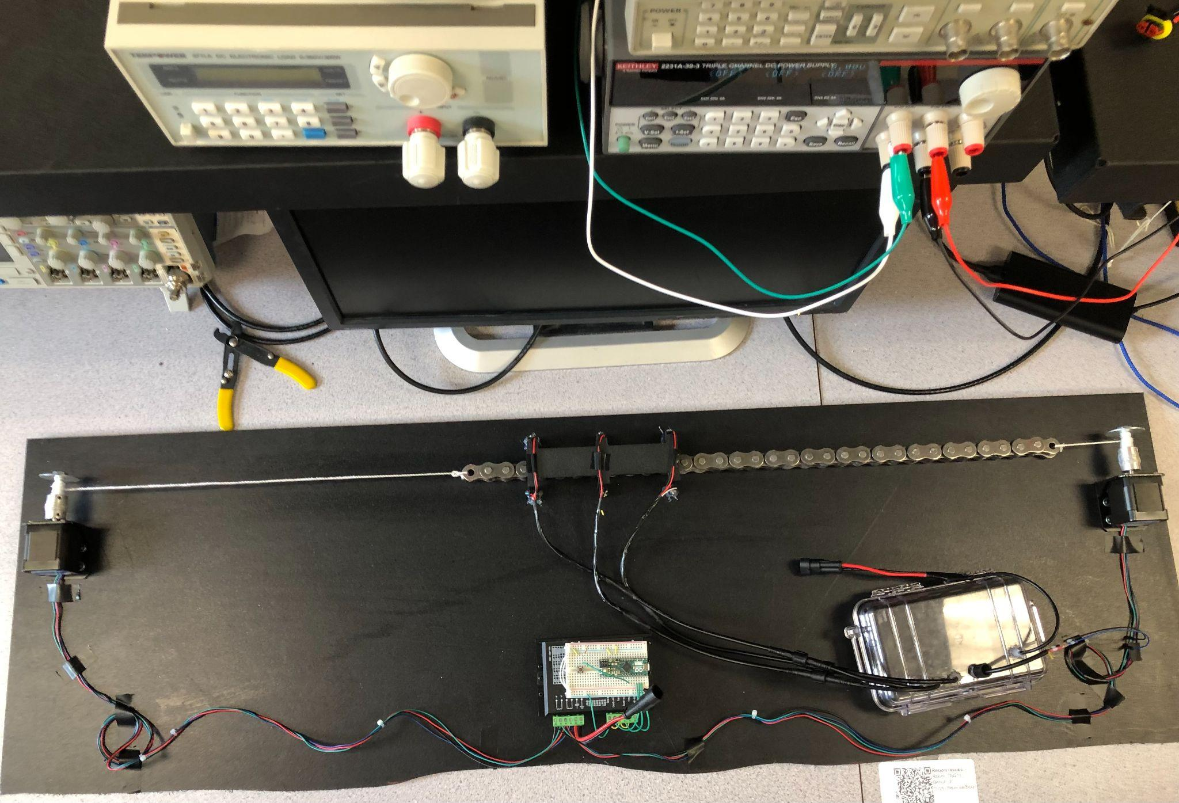
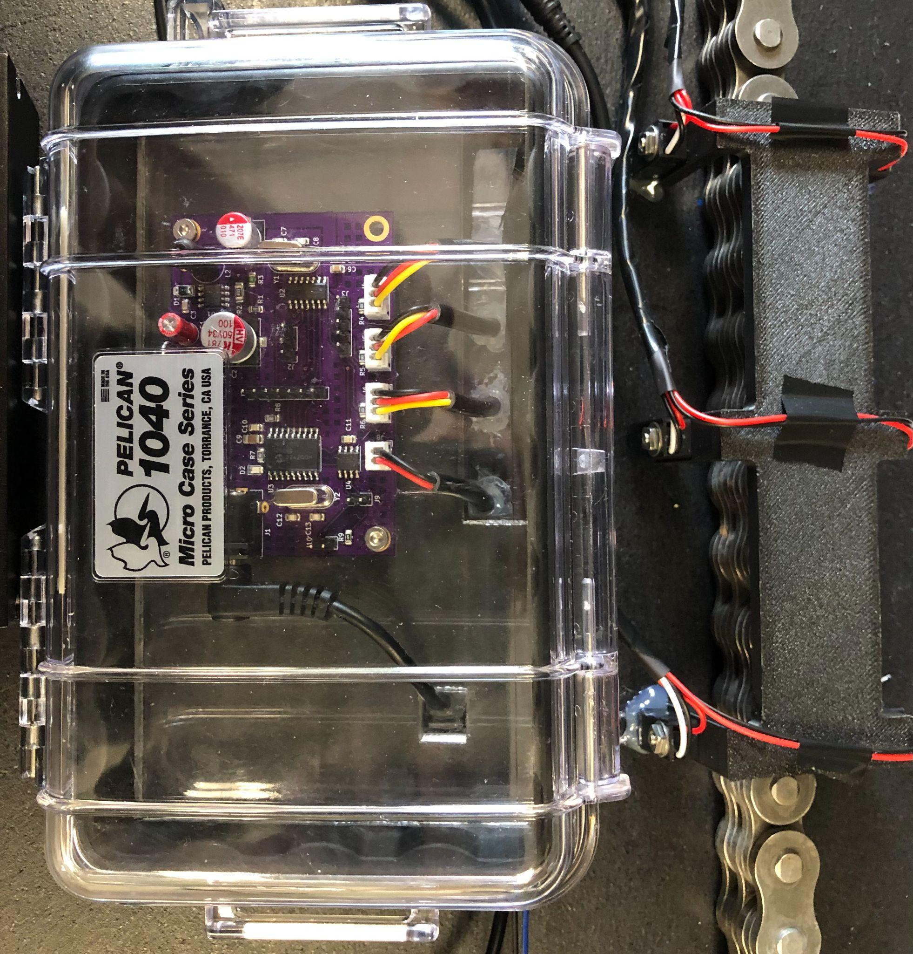

ECE.15
Engineering Requirements
Forklift Chain “Stretch” Monitor
The System will…
PCB - Have a single PCB that is no larger than 6 inches squared and contains all non-sensor circuits.
Power Input - Operate on 24VDC with up to 3Vpp of noise and 500mA peak of current.
Project Partner Checkoff - Be approved by a Hyster-Yale electrical engineer (project partner).
Robust Enclosure - Continue to operate at designed accuracy after 250 chain rotations.
Sensor Accuracy - Measure chain “stretch” within +/- 5% of the actual value.
Signal Output - Communicate with the Hyster Forklift’s electronics using a 5V digital serial signal.
System Cost - Cost less than $15 at a production quantity of 15,000/yr, including the enclosure.
Water Resistance - Function normally after applying a 12oz bottle of water from above.
Non-Contact Sensor to Determine Chain Wear for Heavy Duty Applications
Project Summary
CAN Controller
The Controller Area Network (CAN) is one way of facilitating communication between electronic components
CAN is a standard communication system in vehicles and allows for different sensors and components to communicate on the same line/bus in a priority-driven manner
Many modern vehicles, and importantly Hyster Yale forklifts, use CAN controls
Information from more crucial components is transmitted before other, less important devices all on the same network
Fig. 5. Hyster Forklift
Our project is intended to determine whether it is feasible to create a reliable chain wear detection device that is economical. Hyster-Yale currently uses chain wear detection devies and our goal was to create a proof of concept that Hyster-Yale can obtain and improve upon.
Fig. 1. Block diagram of the system
Power Filter/Converter
Team Members
Power supply with input from 24V battery
Operates between 21-27VDC and up to but not including 500mA of current
Uses a step-down converter (buck converter) to step down voltage and filter (LC) noise from the battery
Efficiency rated between 66-80%. Efficiencies vary based on current
Can replace fuse for circuit protection from current spikes from the battery
Fig. 2. Assembled PCB
Fig. 6. All four members
Chain Measurement Sensor
(From left to right)
Tianhao Lin:
Microcontroller/CAN Controller Designer
lintia@oregonstate.edu
Adam Grzelewski:
Power Converter/Filter Designer
grzelewa@oregonstate.edu
Corbin Krecklow:
Programmer and Enclosure Designer
kreckloc@oregonstate.edu
Kai Roy:
Sensor and PCB Design
kaikurisakaroy@gmail.com
Three IR Break beam Sensors are used to measure Chain Elongation
One sensor is used to measure speed, which the others are used to measure the elongation
The timing difference between the sensors coupled with the speed gives us the elongation
A 3D Bracket was designed for the sensors to keep the distance between them both constant and known for the measurement calculations
Fig. 4. Test bench used to determine the accuracy and durability of the system
Enclosure
Our enclosure consists of a pelican case with an acrylic plate for the custom PCB and holes drilled and then sealed to allow for waterproof cables to be added to the system. These cables connect to the Power, CAN, and sensors.
Fig. 3. Sensors bracket and PCB enclosure

